Slide 1
Tableau Project on Sales Data - June Cohort
File created on: 11/25/2019 10:38:51 PM

Slide 2
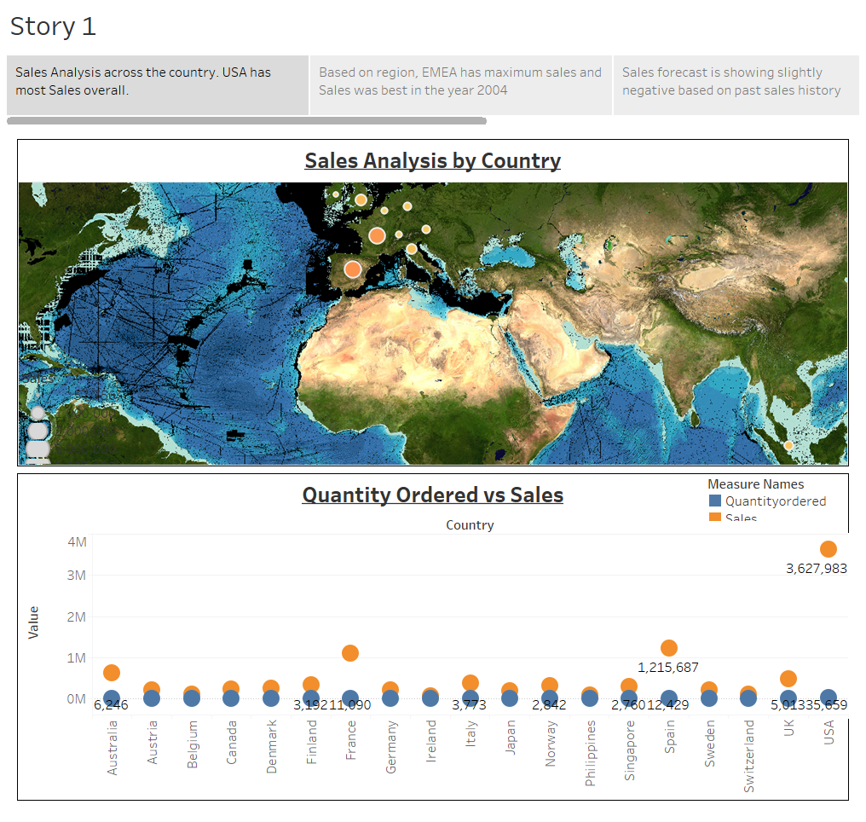

Slide 3
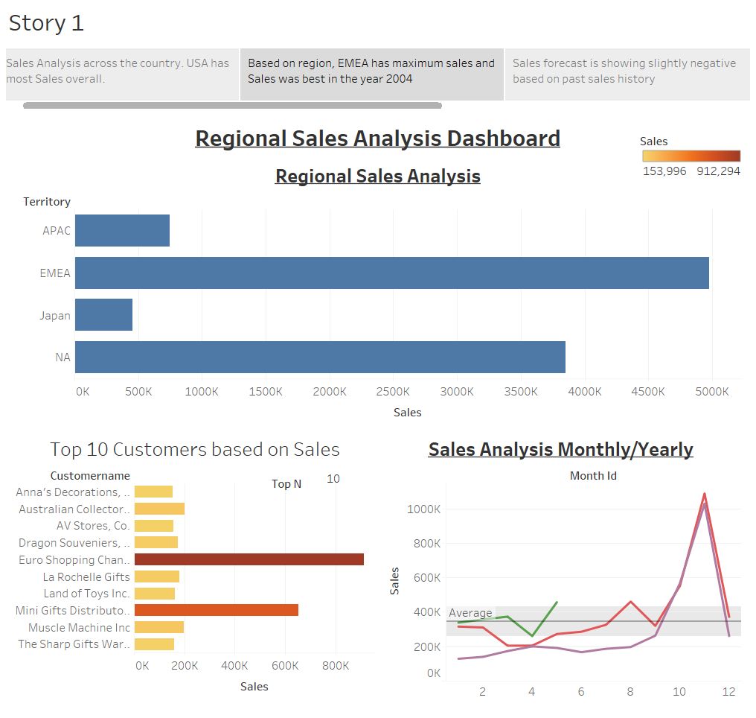

Slide 4
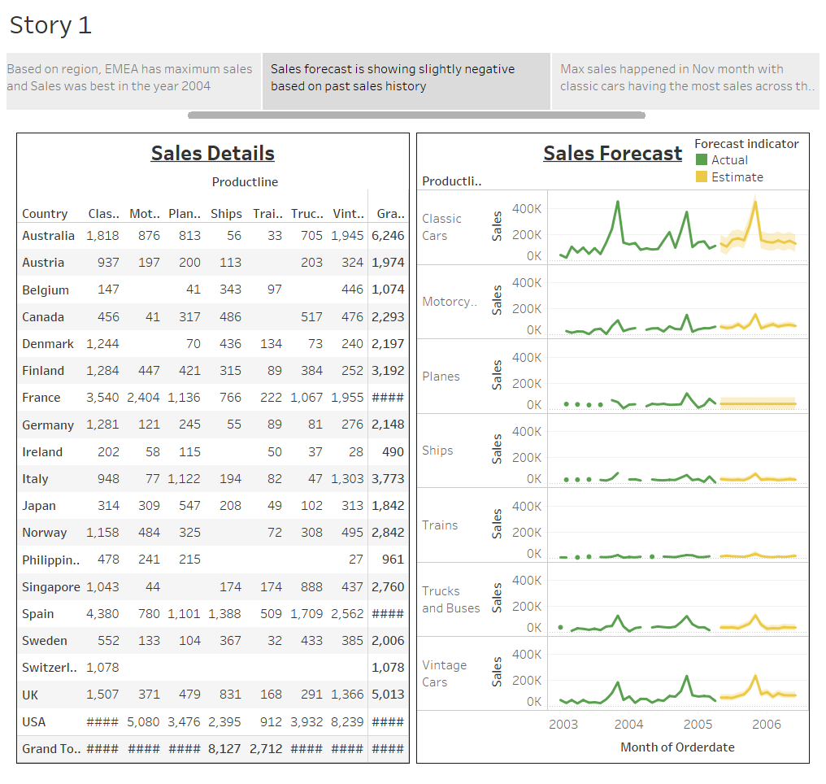

Slide 5
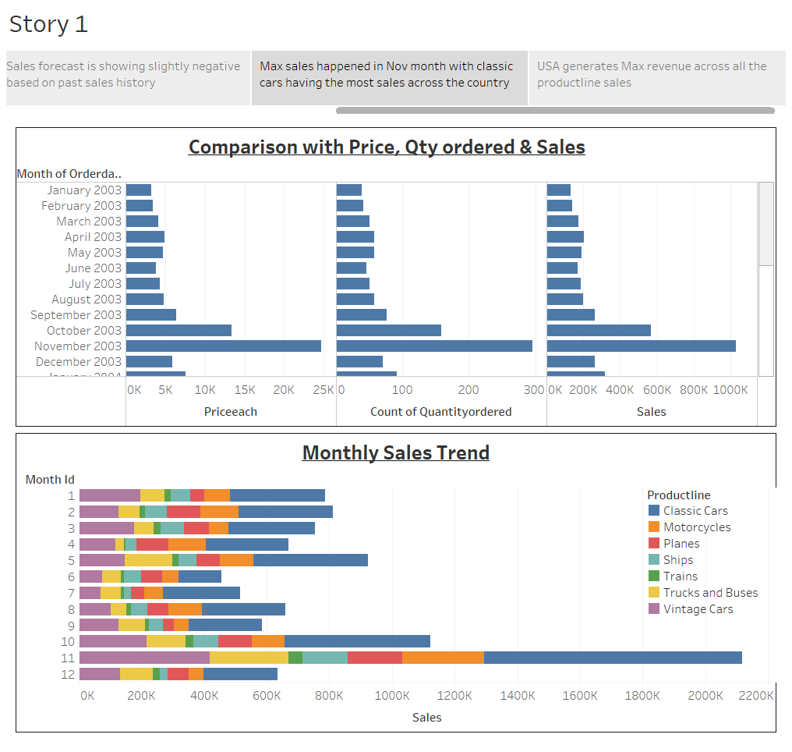

Slide 6
